Slide 1
Roanoke Food Deserts
Levi Buck

Slide 2
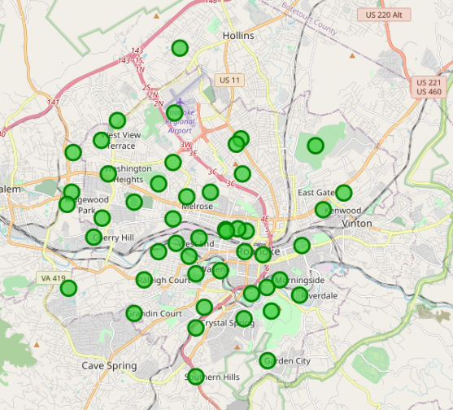
Roanoke City’s Neighborhoods
Roanoke’s approximately 50 neighborhoods are mapped to the right.
Most of these are relatively densely populated, with the few “outliers” around the east, far south, and west representing more suburban areas.
Data was populated from Wikipedia, Google Maps, and official local government sources.

Slide 3
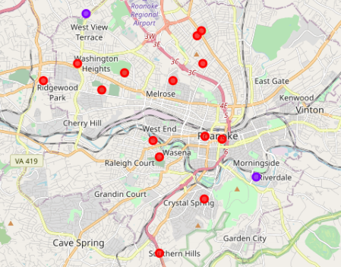
Roanoke City’s Grocery/Food Clusters
Neighborhoods were essentially clustered on their density of grocery stores and supermarkets, using the number of stores within a half-mile of the center of the neighborhood.
Red neighborhoods tend to have around one or two stores; blue, slightly more.
Note that several neighborhoods completely dropped from the map; these often have no grocery stores or supermarkets near the centers of the neighborhoods.
Data was scraped from Foursquare.

Slide 4
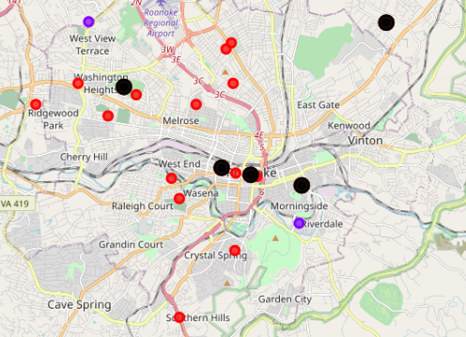
Roanoke City’s Poverty Centers
Using Zipatlas data that was scraped using Python and mapped using Folium, the city’s centers of poverty were placed on this map.
Only the city’s poorest areas were marked- those with a poverty level above the national average of 9.2%.
Note that the poverty centers rest close to low-density grocery store areas, and mostly fall in areas where there are no walkable grocery options.

Slide 5
Conclusion
Food deserts in the city of Roanoke are a reality, and from this research it appears that the challenges are worse than was first believed. Food accessibility is vital for a growing and prosperous city, and using research like this is how we best target the places that need support the most.

